Slide 1

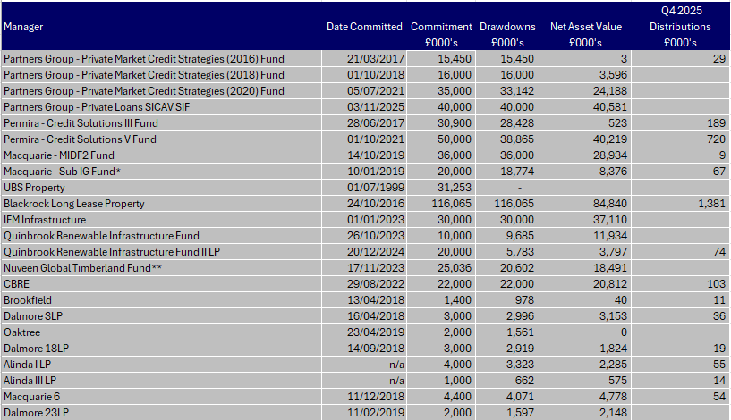
Scottish Borders Council Pension Fund Private Equity Capital Funds Q4 2025

Slide 2
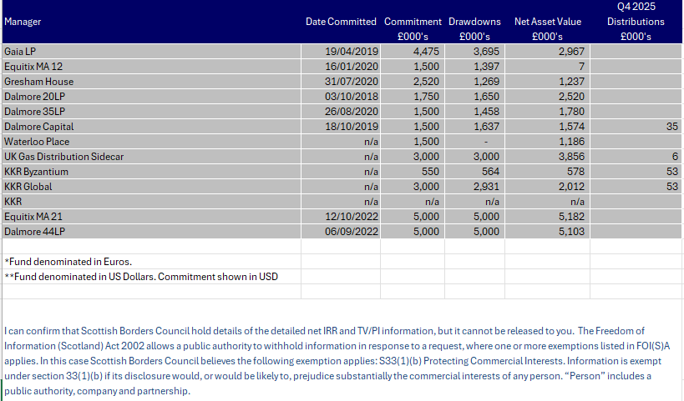
Scottish Borders Council Pension Fund Private Equity Capital Funds Q4 2025

